Slide 1
Tableau

Slide 2
Introduction
Is a powerful data visualization tool, it is used in a specific industry known as the business intelligence industry
It helps in simplifying the raw data in a very easily understable format
It help in creating customized dashboards and prepared reports

Slide 3
Facts of Tableau
User can create dashboards ,depciting trends and variations
Tableau can connect to files ,relational and Big Data sources to acquire and process data (50+ sources)
It provides data blending and real-time color features as well
It is used by busines ,academic researchers and many government organizations for visual data analysis
It is also positioned as a leader Business Intelligence and Analytics Platform in GartnerMagic Quadrant

Slide 4

Features of Tableau
Data Blending
Real time analysis
Collaboration of data

Slide 5
Tableau Products
Tableau Desktop
Tableau Public
Tableau Online
Tableau Server
.Tableau Reader
Developer Tools
Sharing Tools

Slide 6
Tableau Desktop
Tabeau Desktop Personal
Tableau Desktop Professional
Notes:
Tableau Desktop delivers everything you need to access, visualize, and analyze your data. With an intuitive drag and drop interface, you can uncover the hidden insights you need to make impactful business decisions faster, even when you are offline. All while leveraging trusted and governed data in a secure self-service environment.

Slide 7

Tableau Public
It is a free application and visualization hosting service for sharing of pubicly available data on the web
One can share over the cloud on Tableau Public, they would be fully accessible by everyone
Notes:
Tableau Public is a free platform to explore, create and publicly share data visualizations online. With the largest repository of data visualizations in the world to learn from, Tableau Public makes developing data skills easy. Advance your career in analytics by learning from limitless data inspiration and creating an online portfolio of work.

Slide 8

Tableau Server
It is again a software that is specifically used to share the workbooks, show the visualizations and anything else that is created in the Tableau desktop application across the organization
whatever you publish on Tableau Server has a limited access. Only the people whom you have chosen can access the particular visualization or the particular report
There are numerous ways to set up permissions for the users on Tableau Server
It is a pait tool
Notes:
Tableau Server
is Scalable, Secure & Enterprise-Ready. Get Free Trial! Empower your business by putting analytics where your employees, partners, and need them! Drag & Drop.

Slide 9

Tableau Online
It is a online sharing Tool
Its functionality is similar to tableau server
the data is stored on servers that are hosted in the cloud which are maintained by Tableau Group
There is no storage limit
Notes:
Tableau Online is a fully-hosted SaaS that enables users to perform self-service data analytics through the cloud from any device, anywhere at any time. It can create advanced visualizations that draw data from a variety of database sources and convert that data into understandable results.
Tableau Online is a cloud-hosted version of Tableau Server that gives you all the benefits of Tableau Server outside your existing IT frameworks.

Slide 10

Tableau Reader
A free tools that allow us to view the workbooks or visualizations that were created either using tableau Desktop or Tableau Public
It is read only of the report that have been created earlier.
Notes:
to open and interact with packaged workbooks with extracted data sources that have been created in Tableau Desktop. A packaged workbook contains a copy of the data source that the workbook references, so that you don't need to have access to the source data to see and interact with the views

Slide 11
Use of Tableau
Business Intelligence
Data Visualization
Data Collobration
Data Blending
Real-time data analysis
Query translation into visualization
To import large size of data
To create no-code data queries
To manage large size metadata

Slide 12
Why Tableau
Prefect visualization too used for analysis
options tooptimize and enhance the progress of an operation
Most suitable for quick and easy representation of big data
Extensive options to secure data without scripting
Used without any coding knowledge
Comes with different products -product suite
Tableau is integrated with over 250 applications

Slide 13
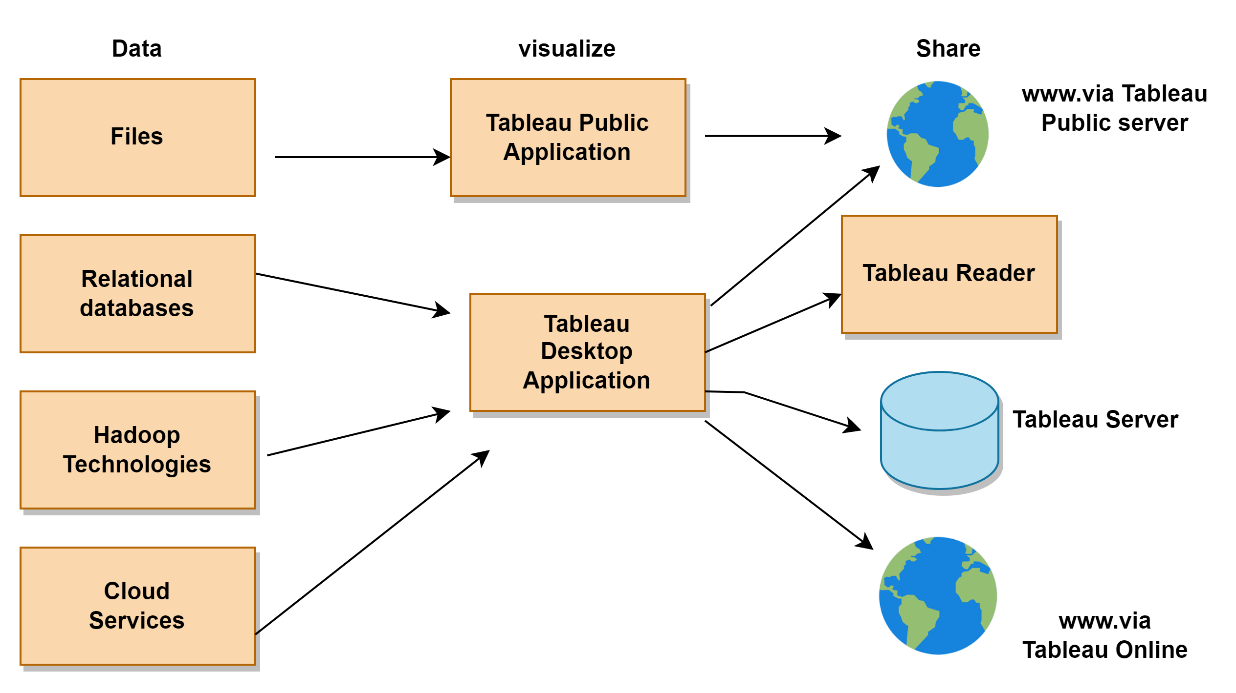
Tableau Product Diagram
Notes:
Hadoop Tech -- such as Hortonworks hadoop Hive and cloudera Hadoop
cloud sources -- such as Google Analytics and Salesforce

Slide 14
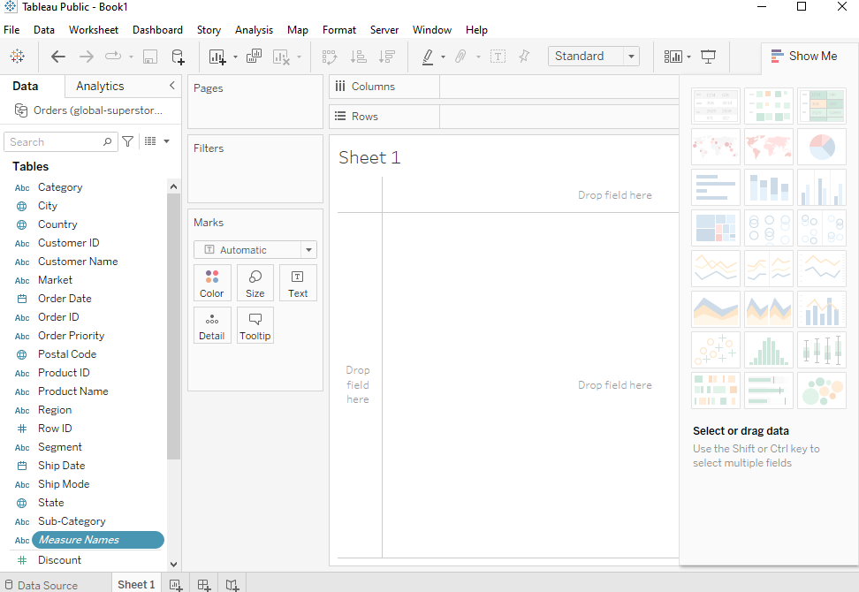
Tableau Interface

